Slide 1

Phase 1, Module 9: Advanced Functions & Performance
Khyber AI Systems Engineer (KASE)
Welcome to Module 9. Today we move beyond basic functions. We will learn how to write code that can handle any amount of data, add features to existing functions automatically, and process massive datasets without running out of memory.
Presented Zaryab Ahmad

Slide 2
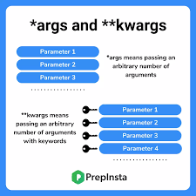

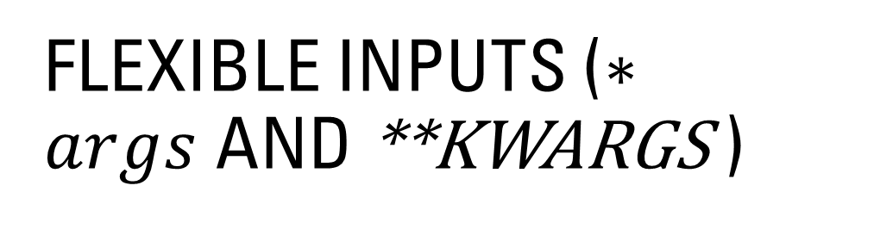
Flexible Inputs ($∗args$and **kwargs )
The "Packing" Mechanism
$∗args:$Collects extra positional arguments into a Tuple.
**kwargs: Collects extra keyword arguments into a Dictionary.
Why: In AI development, your model might have 5 settings today and 50 settings tomorrow. These tools allow your functions to adapt without breaking.

Slide 3
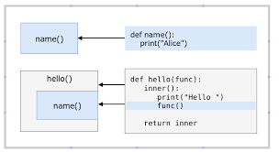

Decorators (The System Wrapper)
Modifying Behavior Without Changing Code
A function that takes another function as an input and "wraps" it with new logic.
AI Use Case: $@timer$– Automatically measuring how long an AI model takes to make a prediction.
System Use Case: $@log⁡$– Automatically saving a record every time a function is called.

Slide 4
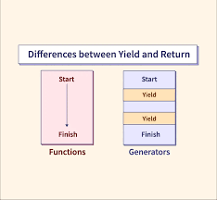

Generators (Memory Efficiency)
yield vs $return$
$return$: Hands back the whole list at once (Uses lots of RAM).
yield: Hands back one item at a time, only when asked (Uses almost zero RAM).
AI Use Case: Streaming a 50GB dataset into a model.

